Slide 1


Department of Computer Science and Engineering
FRAUD DETECTION WITH AI-POWERED SYSTEM USING BLOCKCHAIN TECHNOLOGY
JERRISH N (211421104111)
MICHAEL JOSIL M (211421104161)
PARUN VIGNESH T (211421104180)
MR KARTHIKEYAN A PROFESSOR
DR R. JOSPHINELEELA SUPERVISOR

Slide 2
Abstract
The rapid adoption of blockchain-based financial systems has introduced new security challenges, particularly in cryptocurrency transactions. This project presents an AI-powered Bitcoin wallet that integrates secure wallet generation, transaction management, and real-time fraud detection. The system employs encryption techniques for private key protection and address generation, ensuring secure wallet creation. Transaction processing features enable seamless sending, receiving, and logging of Bitcoin transactions. An AI-based anomaly detection algorithm continuously monitors transactions to identify suspicious activities, enhancing the security and reliability of digital wallets. This integration of artificial intelligence with blockchain technology improves fraud prevention, promotes transparency, and strengthens trust in decentralized financial systems.

Slide 3
Introduction
The rapid growth of blockchain-based financial systems has introduced significant security challenges, particularly in detecting fraudulent transactions due to the decentralized and pseudonymous nature of blockchain networks.
Traditional fraud detection mechanisms relying solely on cryptographic security and consensus algorithms often fail to identify real-time anomalies, making blockchain transactions susceptible to money laundering, double-spending, and other illicit activities.
This project proposes an AI-Powered Blockchain Integrity and Fraud Detection System that integrates Random Forest (RF), Artificial Neural Networks (ANN), Long Short-Term Memory (LSTM), and Isolation Forest models to analyze transaction patterns and detect fraudulent activities with high accuracy.

Slide 4
By leveraging both supervised and unsupervised machine learning techniques, the system continuously monitors transactions, assigns fraud probability scores, and ensures transparency by logging flagged transactions on the blockchain.
Additionally, the system enhances security through an adaptive consensus mechanism based on Byzantine Fault Tolerance (BFT) to prevent fraudulent transactions from being validated.
The integration of AI-driven anomaly detection with blockchain technology significantly improves fraud prevention, enhances transaction security, and strengthens trust in decentralized financial systems.

Slide 5
Objective of the Project
The primary objective of this project is to develop an advanced AI-powered fraud detection system for blockchain transactions, leveraging machine learning algorithms to detect and mitigate fraudulent activities in real time.
With the increasing adoption of blockchain across various industries, particularly in financial applications like cryptocurrencies, cybercriminals exploit the decentralized and pseudonymous nature of transactions, making fraud detection challenging.
By integrating AI-driven anomaly detection models, this project aims to enhance security, transparency, and accuracy in fraud detection by analyzing vast transaction datasets, identifying suspicious patterns, and dynamically adapting to emerging threats.

Slide 6
Utilizing techniques such as supervised and unsupervised learning, deep learning, and real-time predictive analytics, the system will provide robust and scalable fraud detection capabilities.
Unlike conventional centralized systems prone to single points of failure, this project will implement a decentralized AI-driven framework that aligns with blockchain principles, incorporating smart contracts, decentralized computing, and secure data-sharing mechanisms to ensure efficiency and trust.
Ultimately, this project aspires to revolutionize fraud detection in blockchain ecosystems by providing an adaptive, intelligent, and scalable solution that safeguards financial transactions, prevents illicit activities, and fosters greater trust in decentralized digital economies.

Slide 7
Literature Survey
S.NO | Title of the Paper | Methodology | Advantage | Disadvantage
1) | Integrating Reliable AI to Boost Blockchain's Transparency and Accountability (G. B. Renuka et al., 2024) | Integration of AI algorithms with blockchain to enhance fraud detection, real-time validation, and anomaly detection. | Improved fraud detection accuracy (95%), reduced false positives (5%), enhanced scalability, security, and transparency in decentralized networks. | Requires significant computational resources for real-time processing, limited adaptability to novel fraud patterns due to reliance on historical data, scalability concerns.
2) | On the Integration of Artificial Intelligence and Blockchain Technology: A Perspective About Security (O. Kuznetsov et al., 2024) | Examines AI and Blockchain integration with a focus on security, suggesting mitigation strategies like adversarial training, privacy preservation, and quantum-resistant cryptography. | Comprehensive overview of integration benefits, mitigation of adversarial risks, enhanced data privacy, and security through novel cryptographic solutions. | Potential complexity in implementation, significant computational overhead, and regulatory uncertainty in rapidly evolving AI and Blockchain ecosystems.

Slide 8
Literature Survey
3) | A Secure Blockchain Platform for Supporting AI-Enabled IoT Applications at the Edge Layer (S. M. Alrubei et al., 2022) | Proposes a blockchain protocol integrated with edge computing and AI to create a secure, decentralized IoT application for predicting COVID-19 spread in sewage water. | Utilizes low-cost IoT devices and edge computing for AI and blockchain integration, offering high prediction accuracy and minimal impact on device power consumption. | Possible scalability issues and the challenge of integrating biosensors for broader deployment in diverse real-world environments.
4) | A Survey on Blockchain and Artificial Intelligence Technologies for Enhancing Security and Privacy in Smart Environments (F. Oumaima et al., 2022) | Surveys the integration of blockchain and AI technologies to enhance security and privacy in smart environments, focusing on anomaly detection and privacy preservation. | Improves security and privacy for smart environments by leveraging AI algorithms with blockchain's decentralized and transparent nature. | Challenges in real-time anomaly detection and the complexity of integrating AI with blockchain systems at scale.

Slide 9
Literature Survey
5) | The Use of Blockchain to Support Distributed AI Implementation in IoT Systems (S. M. Alrubei et al., 2022) | Proposes a blockchain-based architecture for distributed AI (DAI) on IoT devices, combining Proof of Authority (PoA) and Proof of Work (PoW) consensus mechanisms. | Secure, scalable, and decentralized approach using low-cost IoT devices for AI implementation with high prediction accuracy and minimal energy consumption. | The need for further exploration of off-chain approaches and additional encryption algorithms for real-time applications.
6) | Transparency in Digital-Citizens Interfaces Through Blockchain Technology: BBBlockchain for Participation Processes in Urban Planning (B. Ietto et al., 2022) | A case study-based qualitative research on BBBlockchain, an app designed to enhance citizen participation in urban planning decisions, investigating blockchain's impact on transparency. | Provides insights into how blockchain can be integrated into citizen participation platforms, potentially increasing trust and accountability in urban planning processes. | Blockchain alone may not fully support all transparency dimensions, and challenges in increasing user engagement may persist.

Slide 10
Problem Statement
The rapid growth of blockchain-based financial systems has introduced significant security challenges, particularly in detecting fraudulent transactions due to the decentralized and pseudonymous nature of blockchain networks. Traditional fraud detection mechanisms, which rely solely on cryptographic security and consensus algorithms, often fail to identify real-time anomalies, making blockchain transactions susceptible to money laundering, double-spending, and other illicit activities.
This project proposes an AI-Powered Blockchain Integrity and Fraud Detection System that integrates Random Forest (RF), Artificial Neural Networks (ANN), Long Short-Term Memory (LSTM), and Isolation Forest models to analyze transaction patterns and detect fraudulent activities with high accuracy. By leveraging both supervised and unsupervised machine learning techniques, the system continuously monitors transactions, assigns fraud probability scores, and ensures transparency by logging flagged transactions on the blockchain.

Slide 11
Proposed System
The proposed system in this project introduces an AI-Powered Blockchain Integrity and Fraud Detection System that enhances the reliability, transparency, and security of blockchain networks using Artificial Intelligence (AI) techniques.
Traditional blockchain systems rely solely on cryptographic algorithms and decentralized consensus mechanisms, making them vulnerable to fraudulent transactions, data tampering, and inefficiency in real-time validation.
The proposed system leverages AI-based algorithms to address these limitations, offering real-time anomaly detection, fraud prevention, and adaptive consensus mechanisms.
The system consists of three primary components: Transaction Monitoring Module, AI-Based Fraud Detection Module, and Blockchain Integrity Module.

Slide 12
The Transaction Monitoring Module continuously scans incoming transactions, extracting relevant features such as transaction amount, sender-receiver relationship, and frequency of transactions.
These extracted features are then passed to the AI-Based Fraud Detection Module, where Support Artificial Neural Network (ANN), Random Forest (RF), Isolation Forest (IF), and Long Short-Term Memory (LSTM) neural networks work collaboratively to classify transactions as legitimate or fraudulent. The final decision is taken based on an ensemble approach, where multiple models vote on the classification result.
If a transaction is flagged as fraudulent, it is immediately logged onto the blockchain for transparency, and further actions are taken, such as blocking or requiring additional verification.

Slide 13
Software / Hardware used
Hardware Requirements :
System Device : Mobile or Computer
Processor (RAM) : 4GB (Both mobile and computer)
Computer Storage : 512 GB
Mobile Storage : 32 GB
Internet Connection
Software Requirements :
Mobile OS : Android version 10
Computer OS : Windows 8
Computer Clock Speed : 4.90 GHz

Slide 14
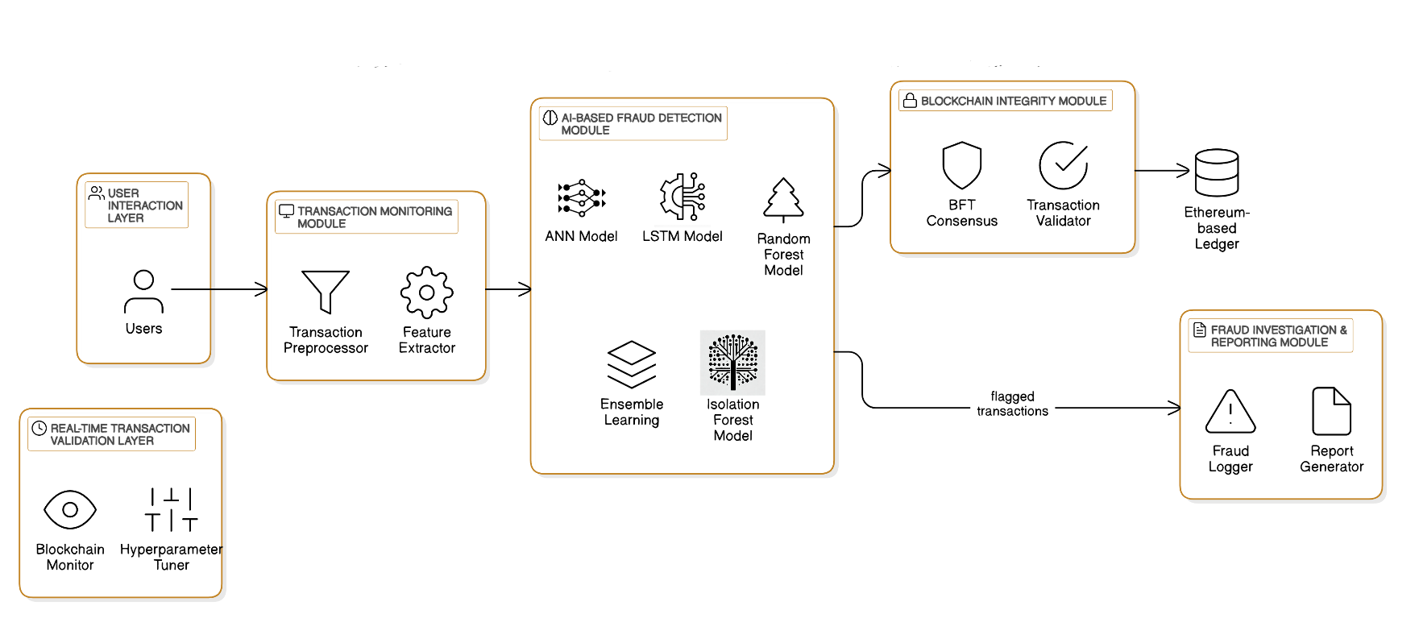
Architecture / Methodology used

Slide 15
The design and structure of this AI-powered blockchain fraud detection system outline a systematic approach to ensuring transaction integrity and security. The architecture integrates machine learning models with blockchain technology to detect fraudulent transactions in real time.
The system comprises multiple interconnected modules, including a transaction monitoring module that preprocesses and extracts relevant features from transactions, an AI-based fraud detection module utilizing ANN, LSTM, Random Forest, and Isolation Forest models for anomaly detection, and a blockchain integrity module that employs Byzantine Fault Tolerance (BFT) for secure transaction validation.
Flagged transactions undergo further scrutiny in the fraud investigation and reporting module, which logs suspicious activities and generates detailed reports. Additionally, a real-time transaction validation layer continuously monitors blockchain activity and refines fraud detection models for enhanced accuracy.

Slide 16
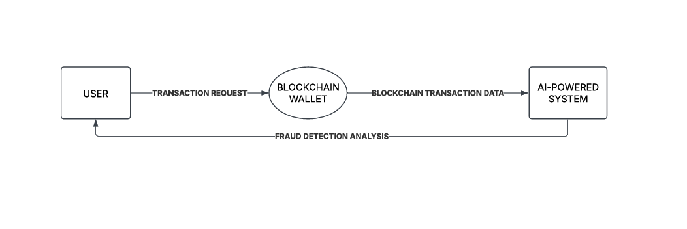
System Design - Flow Chart/DFD/ER
Level 0 DFD

Slide 17
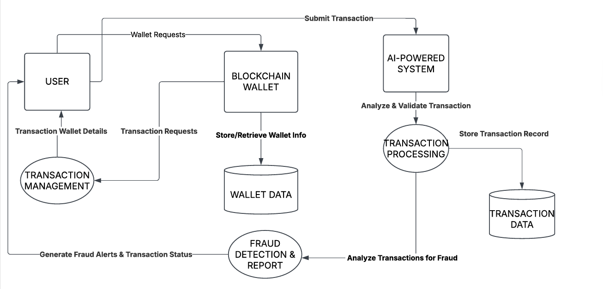
System Design - Flow Chart/DFD/ER
Slide 12 to 15
Flow Chart/DFD/ER Diagram/Use case Diagram/Collaboration /Sequence Diagram
Level 1 DFD

Slide 18
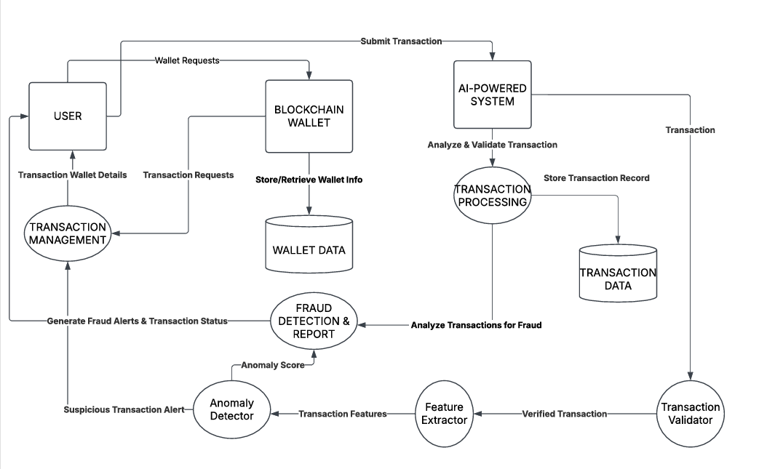
System Design - Flow Chart/DFD/ER
Flow Chart/DFD/ER Diagram/Use case Diagram/Collaboration /Sequence Diagram
Level 2 DFD

Slide 19
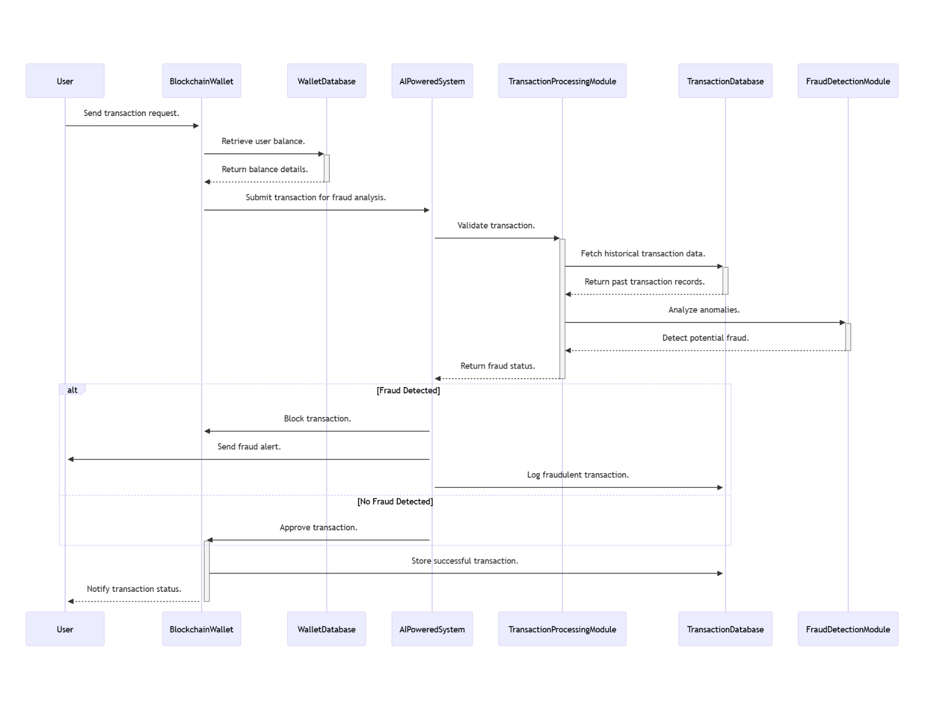
System Design - Flow Chart/DFD/ER

Slide 20
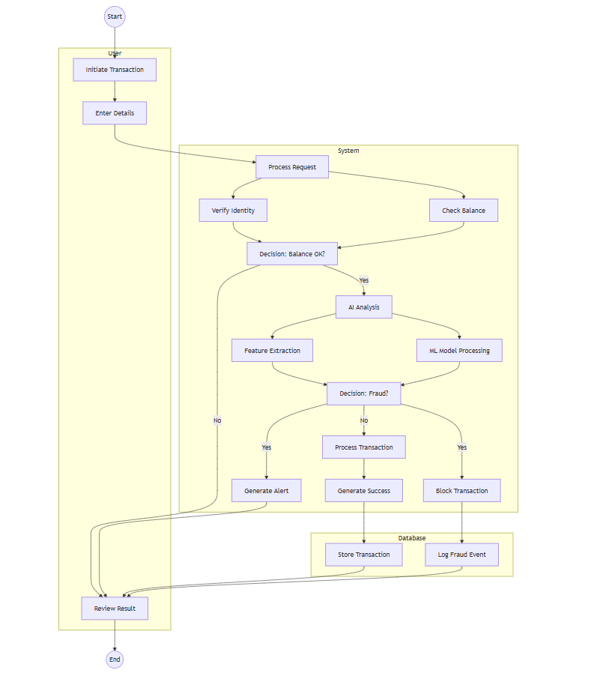
System Design - Flow Chart/DFD/ER

Slide 21
Module Description
Data Overview
The first phase of the system implementation focuses on data collection and preprocessing, which is critical for ensuring the integrity and quality of the dataset used for model training. This process involves gathering transaction data from various blockchain sources, including historical transaction records and user-generated data. The gathered data undergoes thorough cleaning to remove duplicates and inconsistencies, ensuring that it is accurate and reliable. Missing values are addressed through imputation or removal, and the data is normalized to maintain uniformity across features. Additionally, exploratory data analysis (EDA) is conducted to visualize the distribution and relationships within the dataset, which further informs the subsequent feature engineering phase. This foundational work sets the stage for the effective training of artificial intelligence models in detecting fraudulent transactions.

Slide 22
Module Description
AI Model Selection
Once the data is prepared, the project moves into the AI model selection phase, where various machine learning algorithms are evaluated to identify the best performers for the task of fraud detection. The models investigated include Random Forest, Long Short tearm memory (LSTM), Artificial Neural Networks, and more specialized algorithms like Isolation Forest. Each model is subjected to rigorous testing, using metrics such as accuracy, precision, recall, and F1-score to assess their performance. Cross-validation techniques, particularly k-fold validation, are employed to avoid overfitting and ensure that the selected models generalize well to unseen data. This phase emphasizes the importance of selecting the right algorithm, as the effectiveness of fraud detection directly relies on the chosen model's performance characteristics

Slide 23
Module Description
Training and Validation
The third stage encompasses training and validation, which is essential for optimizing the selected models. During this phase, the models are trained on a subset of the dataset, allowing them to learn the underlying patterns that distinguish fraudulent transactions from legitimate ones. The training process involves fine-tuning hyperparameters to enhance model performance. Post-training, the models are validated using a separate validation dataset to assess their predictive capabilities. This includes monitoring various performance metrics and adjusting the models accordingly to strike a balance between precision and recall. By the end of this phase, each model is evaluated not only for its predictive accuracy but also for its robustness in real-world applications, ensuring that they are ready for effective implementation.

Slide 24
Module Description
Real-time Transaction Validation
In the final operational phase, trained models are deployed for real-time transaction validation, a critical feature of the system aimed at providing swift and automatic responses to potential fraudulent activities. The application analyzes incoming transaction data, applying the selected machine learning models to classify transactions as either legitimate or fraudulent in real-time. This process incorporates anomaly detection techniques to flag suspicious transactions quickly, allowing for immediate alerts and actions to prevent fraud. The system is designed to balance high-speed performance with accuracy, minimizing false positives while maintaining sensitivity to true fraud cases. Continuous monitoring and feedback mechanisms are in place to refine the model’s performance over time, ensuring that the system adapts to emerging patterns of fraudulent behavior effectively.

Slide 25
Testing /Performance Evaluation / Results
Software Testing is a critical element of software quality assurance and represents the ultimate review of specification, design and coding, Testing presents an interesting anomaly for the software engineer
Testing objectives
Testing is a process of executing a program with the intent of finding an error
A good test case is one that has a probability of finding an as yet undiscovered error
A successful test is one that uncovers an undiscovered error

Slide 26
Testing /Performance Evaluation / Results
Fraud Detection Accuracy Comparison
Metric | Proposed System | Existing System [7] | Existing System [8]
Fraud Detection Rate | 95% | 85% | 88%
False Positive Rate | 5% | 10% | 12%
False Negative Rate | 8% | 15% | 10%
Model Accuracy | 96% | 87% | 90%

Slide 27
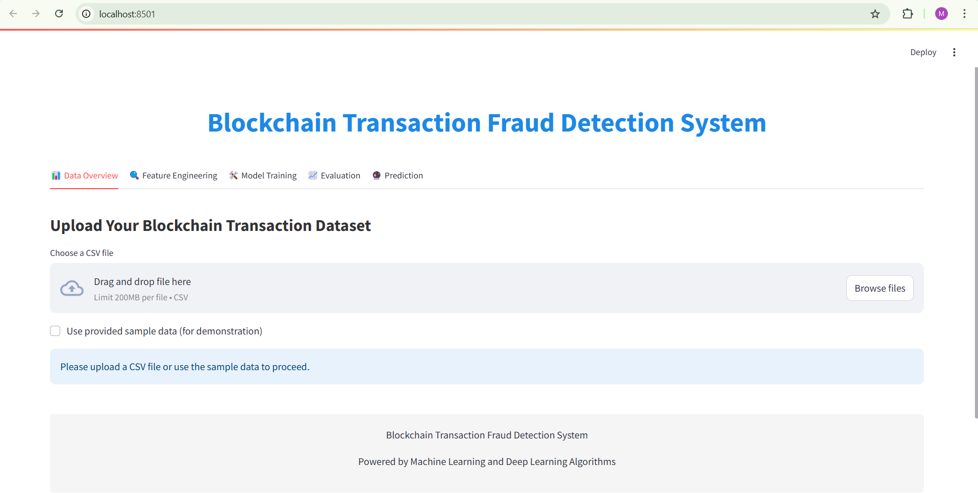
Screen Shots
Slide 22 to 23
DATA INPUT PAGE

Slide 28
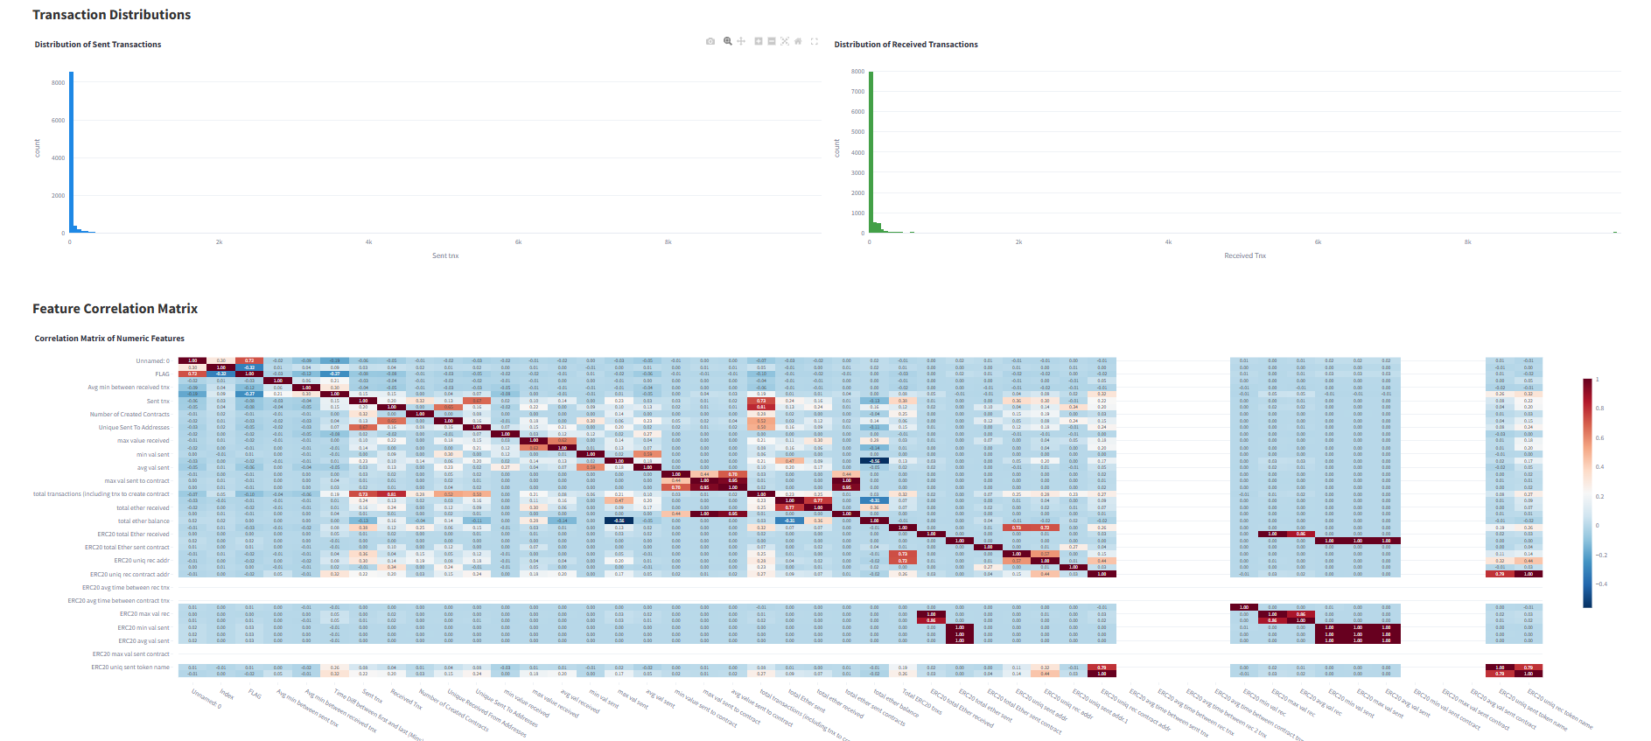
Screen Shots
Slide 22 to 23
DISTRIBUTION VISUALIZATION PHASE1

Slide 29
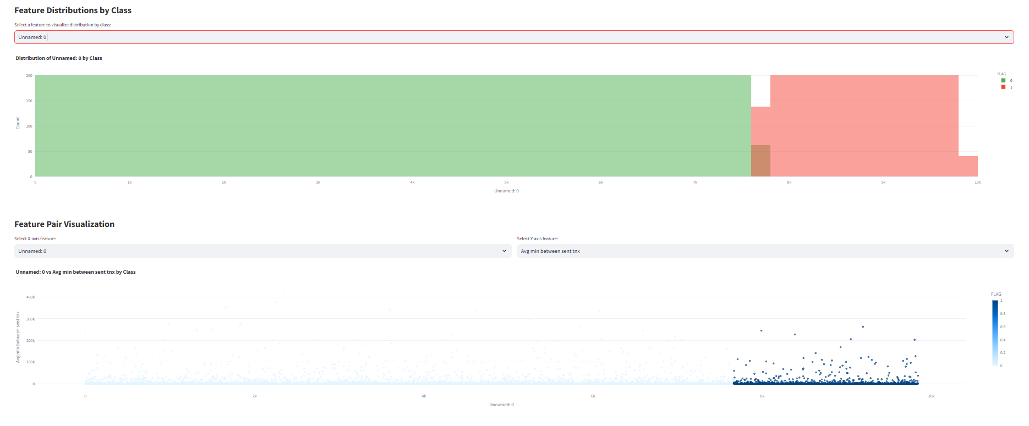
Screen Shots
Slide 22 to 23
DISTRIBUTION VISUALIZATION PHASE2

Slide 30
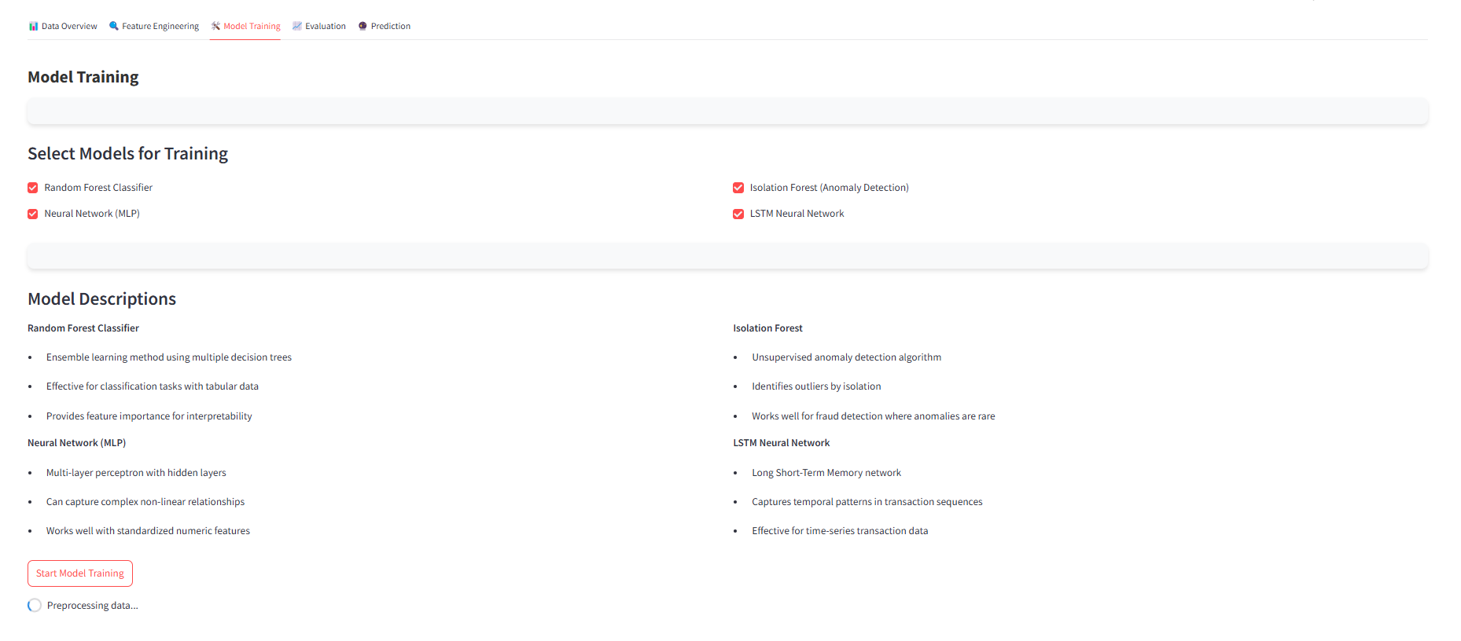
Screen Shots
Slide 22 to 23
MODEL TRAINING

Slide 31
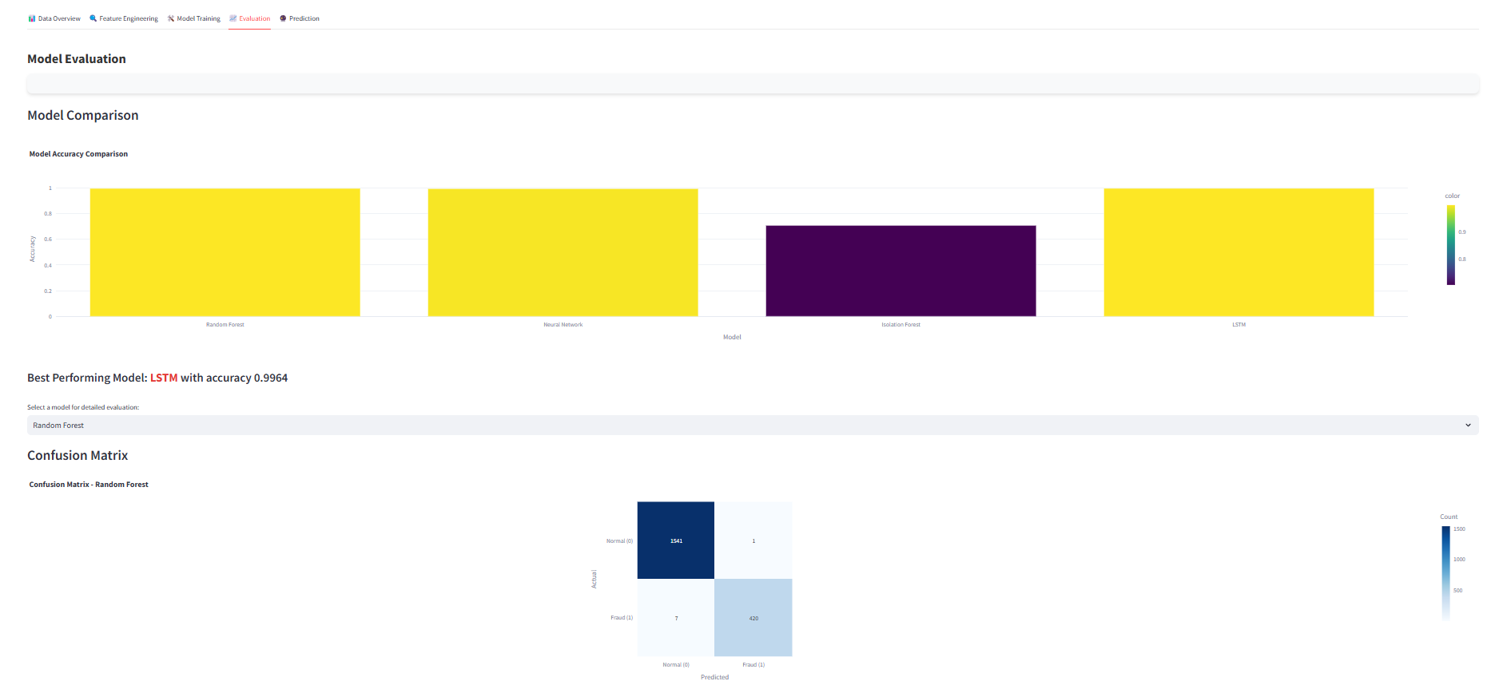
Screen Shots
Slide 22 to 23
MODEL EVALUATION

Slide 32
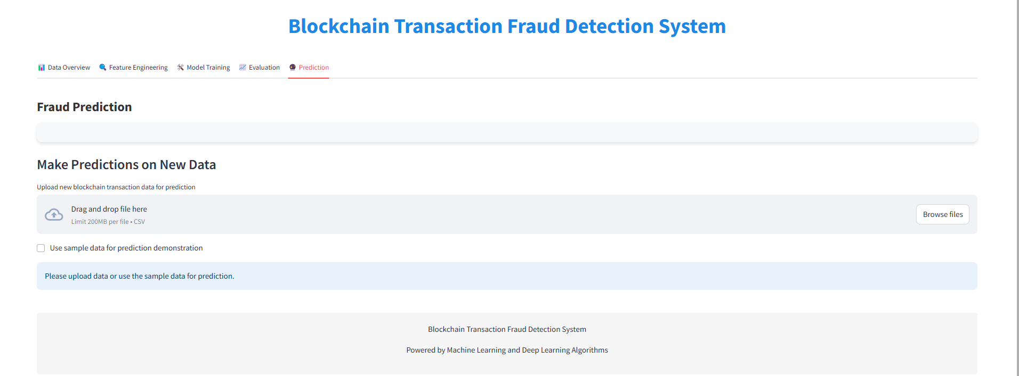
Screen Shots
Slide 22 to 23
DATA TO PREDICT

Slide 33
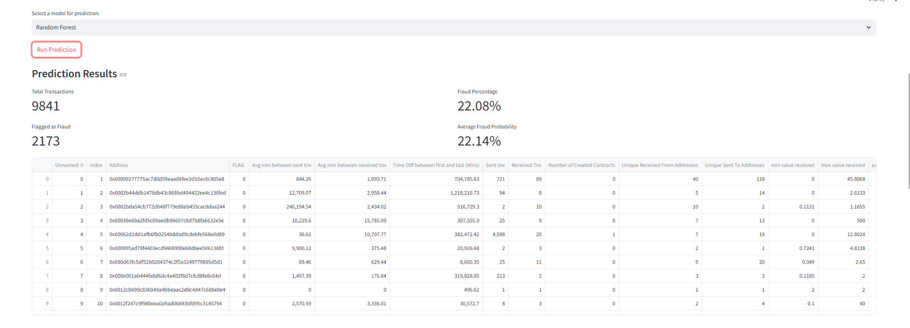
Screen Shots
Slide 22 to 23
PREDICTION PERCENTAGE

Slide 34
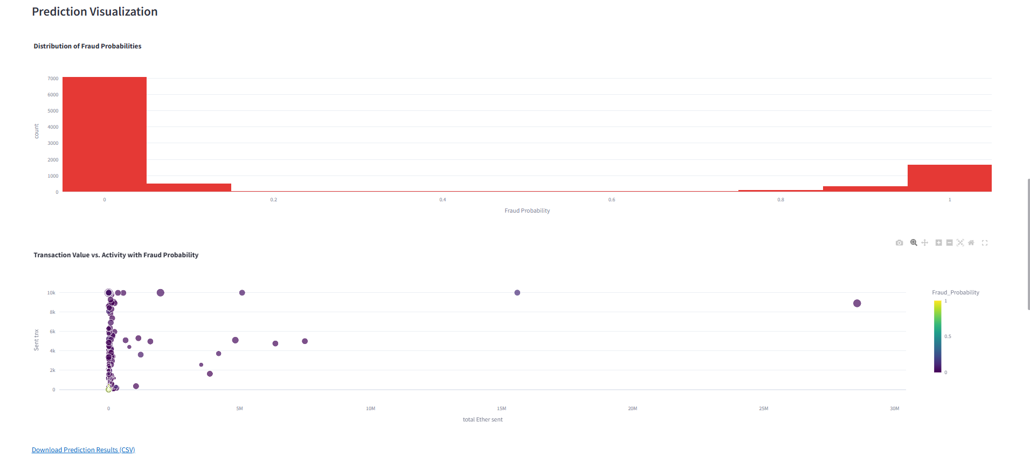
Screen Shots
Slide 22 to 23
PREDICTION VISUALIZATION

Slide 35

Screen Shots
Slide 22 to 23
TRANSACTION RESULT REPORT

Slide 36
Conclusion / Feature Enhancement
The integration of artificial intelligence (AI) with blockchain technology marks a significant advancement in securing digital financial transactions. This project presents an AI-Powered Blockchain Integrity and Fraud Detection System that utilizes models such as Artificial Neural Networks (ANN), Long Short-Term Memory (LSTM), Random Forest (RF), and Isolation Forest (IF) to effectively identify fraudulent transactions. Each model contributes uniquely, capturing anomalies, sequential patterns, and isolating suspicious activities, while ensemble learning further enhances detection performance. The system also features a secure Bitcoin wallet utilizing elliptic curve cryptography (ECC) for transaction management, along with real-time monitoring and adaptive hyperparameter tuning for optimized fraud detection. Additionally, a Blockchain Integrity Module employs Byzantine Fault Tolerance (BFT) to validate transactions on an Ethereum ledger, ensuring only legitimate entries are recorded. The system showcases high accuracy in detecting fraudulent transactions and presents an intelligent approach to fraud prevention through behavioral analysis. While challenges exist, such as the need for continuous model updates and computational demands, future enhancements may focus on scalability, privacy-preserving techniques, and federated learning to better protect user privacy. Overall, this work illustrates the synergistic potential of AI and blockchain to bolster transaction security and trust in cryptocurrency ecosystems

Slide 37
Conclusion / Feature Enhancement
Enhanced User Interface:
Improving the user interface to make it more intuitive will facilitate easier navigation for users of all levels. Incorporating customizable dashboards and visual analytics could empower users to interpret data insights effectively.
Cross-Chain Transactions Support:
Expanding the system's capabilities to support cross-chain transactions would significantly enhance its utility. This integration would enable users to transact seamlessly across different blockchain networks, broadening the scope of fraud detection.
Advanced Machine Learning Technique:
Implementing advanced machine learning techniques, such as deep learning and reinforcement learning, will enhance the system's ability to detect sophisticated fraud patterns. Continuous learning mechanisms could be introduced to adapt to evolving fraud tactics.
Privacy-Preserving Technologies:
Adopting privacy-preserving technologies, such as zero-knowledge proofs, would allow users to verify transactions without exposing sensitive information. This enhancement would bolster user confidence and data security.

Slide 38
Reference Paper/ URL
G. B. Renuka, P. K. Patjoshi, U. Aswal, G. Manikandan, L. N. Jayanthi, and A. Kaushal, "Integrating Reliable AI to Boost Blockchain's Transparency and Accountability," in *2024 1st International Conference on Advanced Computing and Emerging Technologies (ACET)*, Ghaziabad, India, Aug. 2024, pp. 1-6. doi: 10.1109/ACET61898.2024.10730476.
A. Kuznetsov, P. Sernani, L. Romeo, E. Frontoni and A. Mancini, "On the Integration of Artificial Intelligence and Blockchain Technology: a Perspective about Security", IEEE Access, pp. 1, Jan. 2024.
S. Alrubei, E. A. Ball and J. Rigelsford, "A secure blockchain platform for supporting AI-Enabled IoT applications at the edge layer", IEEE Access, vol. 10, pp. 18583-18595, Jan. 2022.
O. Fadi, K. Zkik, E. G. Abdellatif and M. Boulmalef, "A survey on blockchain and artificial intelligence technologies for enhancing security and privacy in smart environments", IEEE Access, vol. 10, pp. 93168-93186, Jan. 2022.
S. Alrubei, E. A. Ball and J. Rigelsford, "The use of blockchain to support distributed AI implementation in IoT systems", IEEE Internet of Things Journal, vol. 9, no. 16, pp. 14790-14802, Aug. 2022.

Slide 39
Reference Paper/ URL
B. Ietto, K. Eisenhut, R. Muth, J. Rabe and F. Tschorsch, "Transparency in Digital-Citizens Interfaces Through Blockchain Technology: Blockchain for Participation Processes in Urban Planning", 2022 IEEE European Technology and Engineering Management Summit (E-TEMS), Mar. 2022.
J. A. Jaoude and R. George Saade, "Blockchain applications—Usage in different domains", IEEE Access, vol. 7, pp. 45360-45381, 2019.
M. Wu, K. Wang, X. Cai, S. Guo, M. Guo and C. Rong, "A comprehensive survey of blockchain: From theory to IoT applications and beyond", IEEE Internet Things J., vol. 6, no. 5, pp. 8114-8154, Oct. 2019.
S. Pahlajani, A. Kshirsagar and V. Pachghare, "Survey on private blockchain consensus algorithms", Proc. 1st Int. Conf. Innov. Inf. Commun. Technol. (ICIICT), pp. 1-6, Apr. 2019.
K. Salah, M. H. U. Rehman, N. Nizamuddin and A. Al-Fuqaha, "Blockchain for AI: Review and open research challenges", IEEE Access, vol. 7, pp. 10127-10149, 2019

Slide 40
Conference / Publication / Patent Certificate/ Project Contest Winner Certificates

